Slide 1

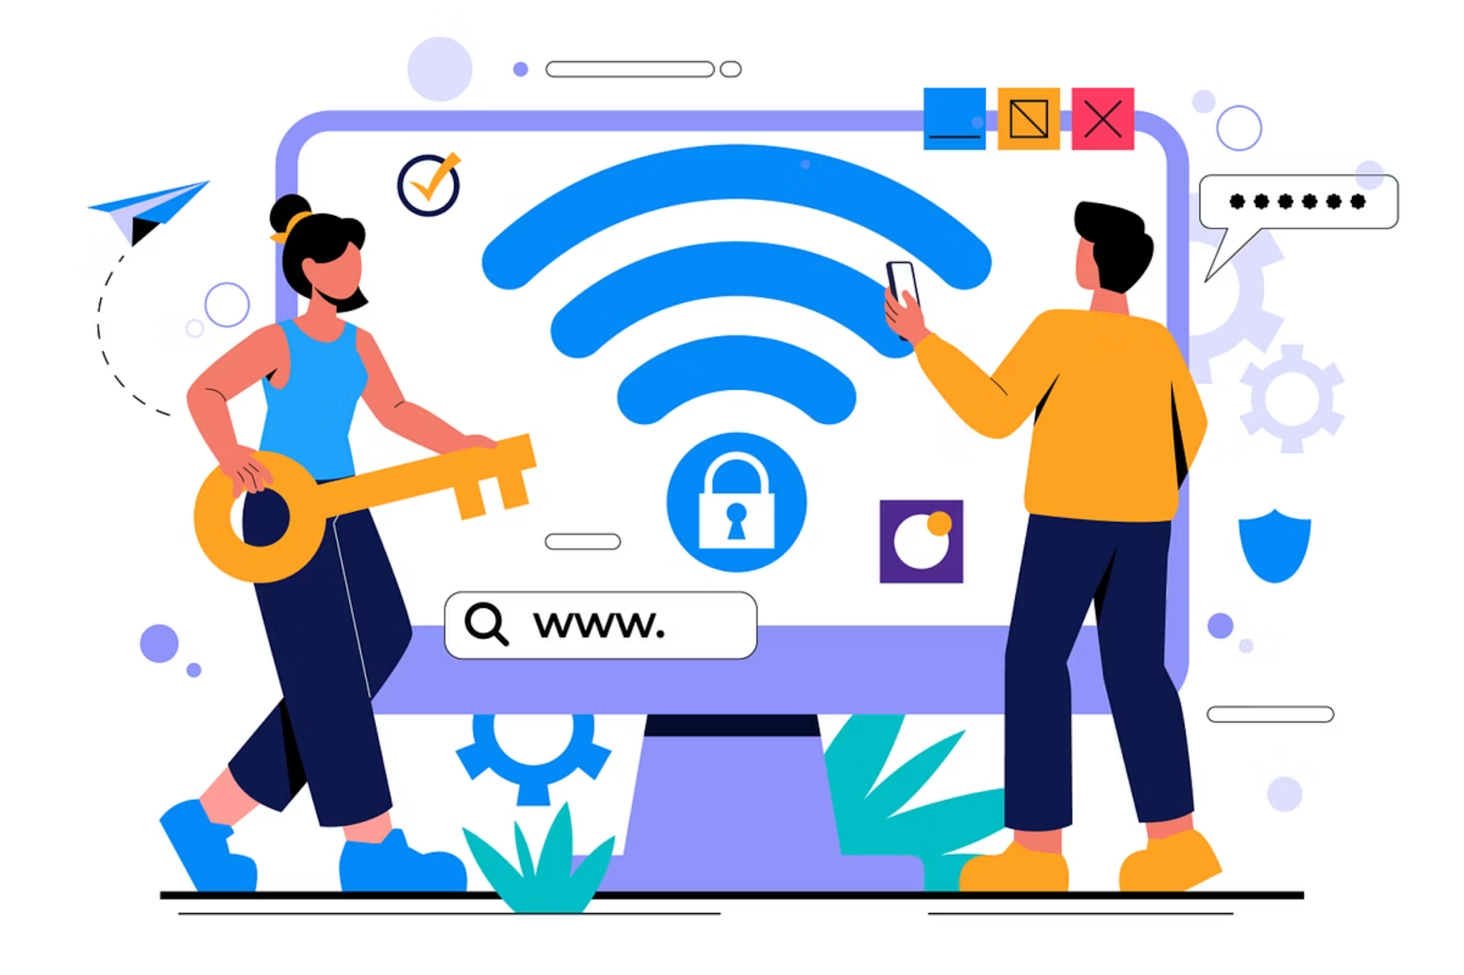
Internet, Networking & Security Basics
Understanding How the Internet Works
1

Slide 2
Session Agenda
01
02
03
What is the Internet?
HTTPS & Security
Real-World Examples
IP Addresses, DNS, Ports
Encryption & certificates
ISP, routers & WiFi security
04
05
Live Demos
Scenario Discussion
ping, nslookup, Network tab
Troubleshooting & Q&A
2

Slide 3
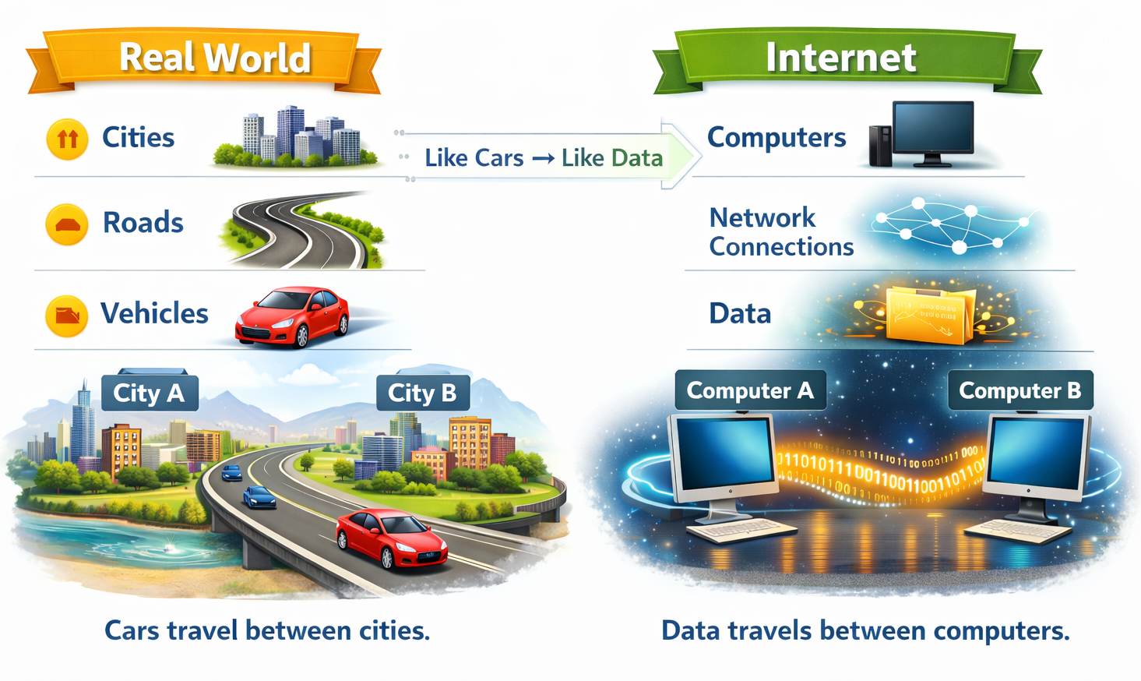
Example: Road Network
CONCEPT INTRODUCTION
What is the Internet?
The Internet is a global network of connected computers communicating using IP addresses. Data is transferred using protocols like HTTP and TCP/IP.
Think of it as a giant network connecting millions of smaller networks.
3

Slide 4

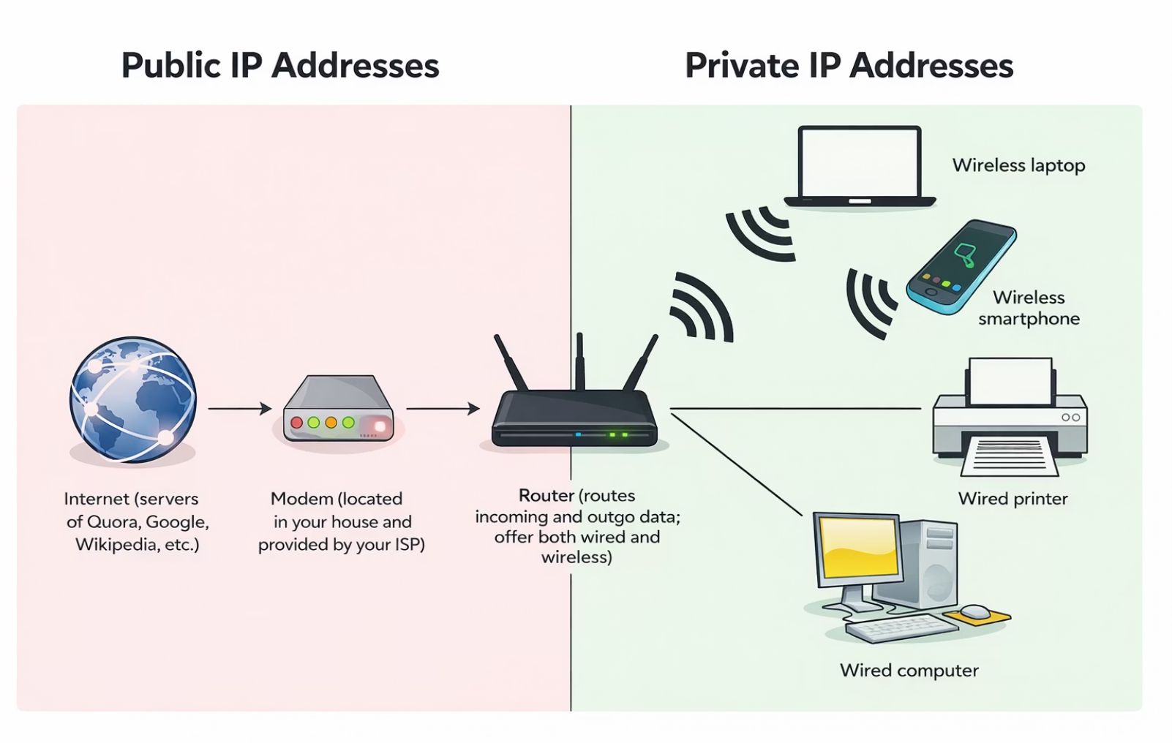
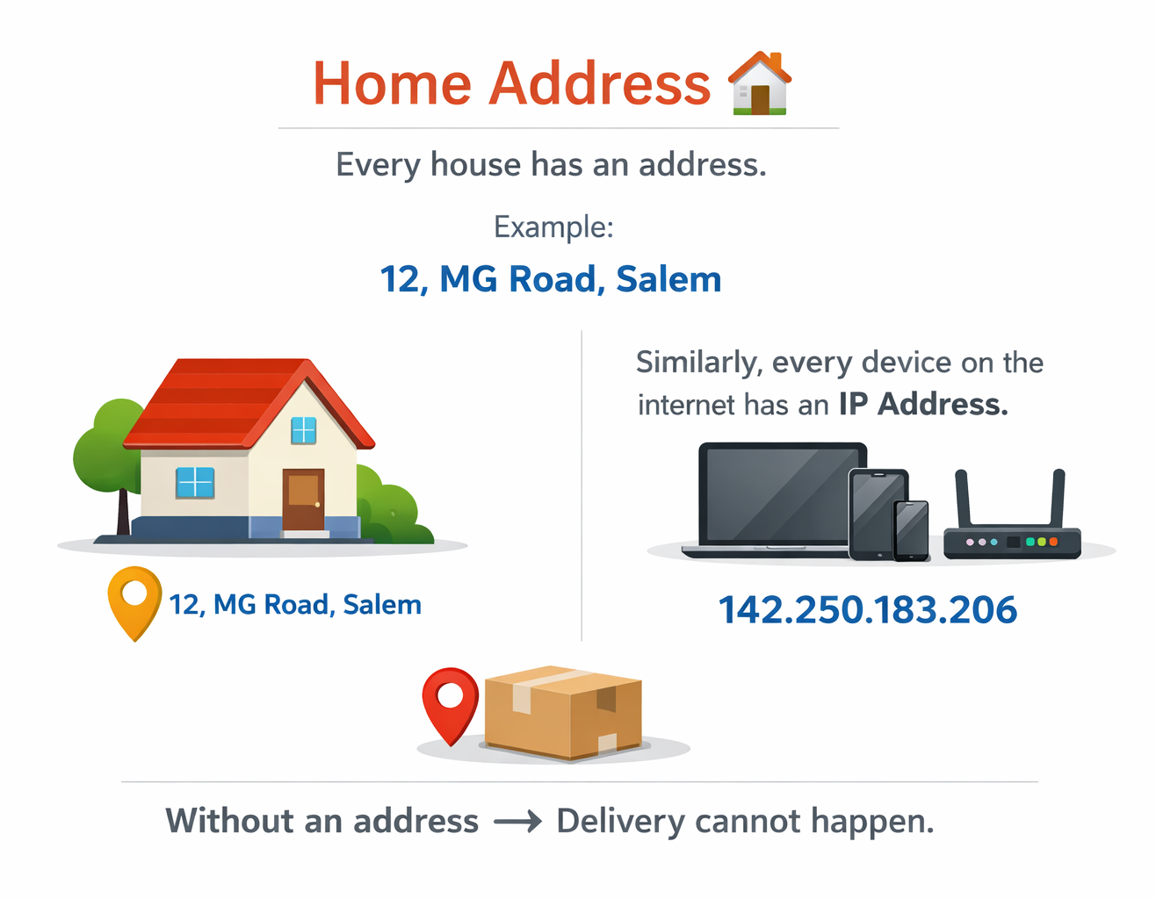
IP ADDRESS
What is an IP Address?
IP = Internet Protocol
An IP Address is a unique address for a device on a network — like a home address for your computer.
Example: Home Address
Private IP
Public IP
192.168.1.10
142.250.183.206
4

Slide 5
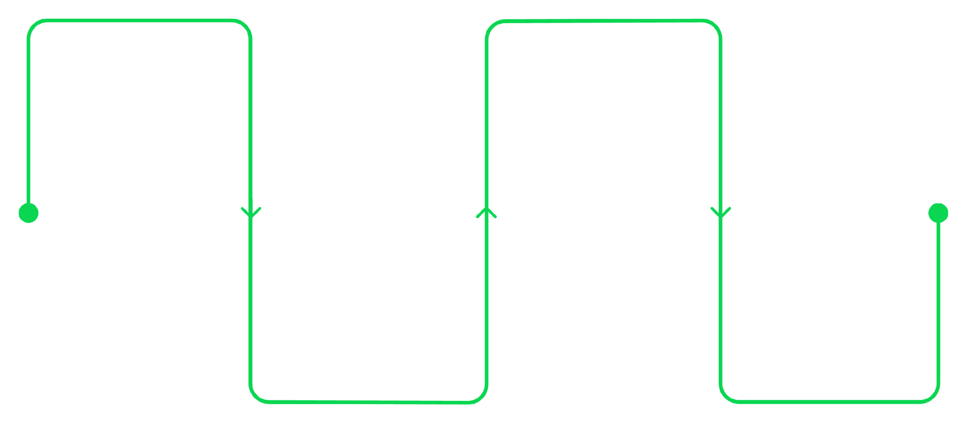
How IP Works
When you visit a website, your device's private IP is converted to a public IP by the router. This process is called NAT (Network Address Translation).
Private IP
To Internet
Device uses a local address
Request travels across the network
Server Response
NAT Translation
Server sends data back to the public IP
Router converts to public IP
NAT allows multiple devices on a local network to share a single public IP address.
5

Slide 6
Quiz Time
Q1. Why does every device on the internet need an IP address?
✅ Answer: Because the IP address helps identify the device and tells the internet where to send the data.
Q2. Can two devices on the internet use the same IP address?
✅ Answer: No. Each device on the internet must have a unique public IP address so data goes to the correct device.
Q3. What might happen if a device does not have an IP address?
✅ Answer: It will not be able to communicate with other devices on the internet.
6

Slide 7
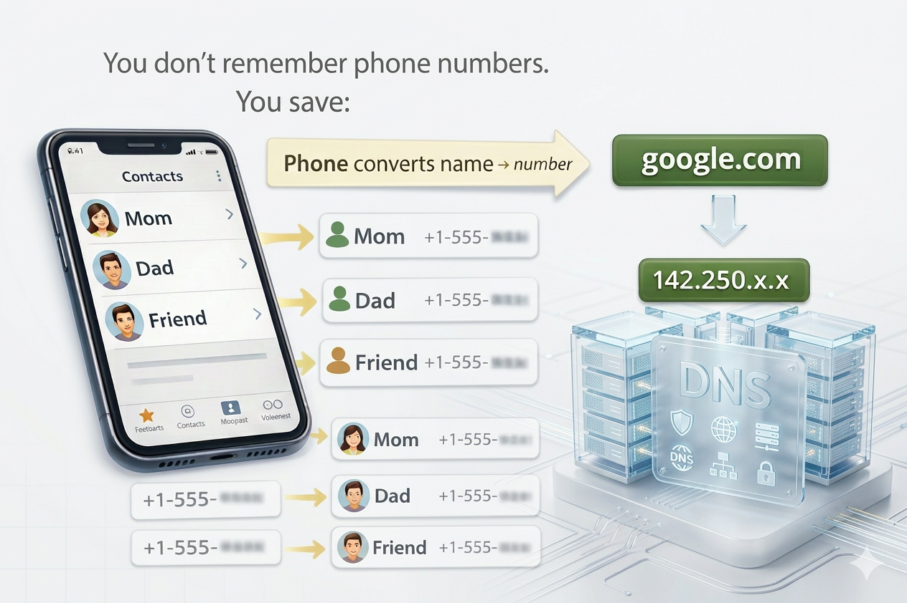


DNS BASICS
What is DNS?
Example: Phone Contact List 📱
DNS = Domain Name System
It converts human-readable domain names into IP addresses.
google.com
Domain Name
142.250.x.x
IP Address
Without DNS, we'd have to remember IP addresses for every website!
7

Slide 8
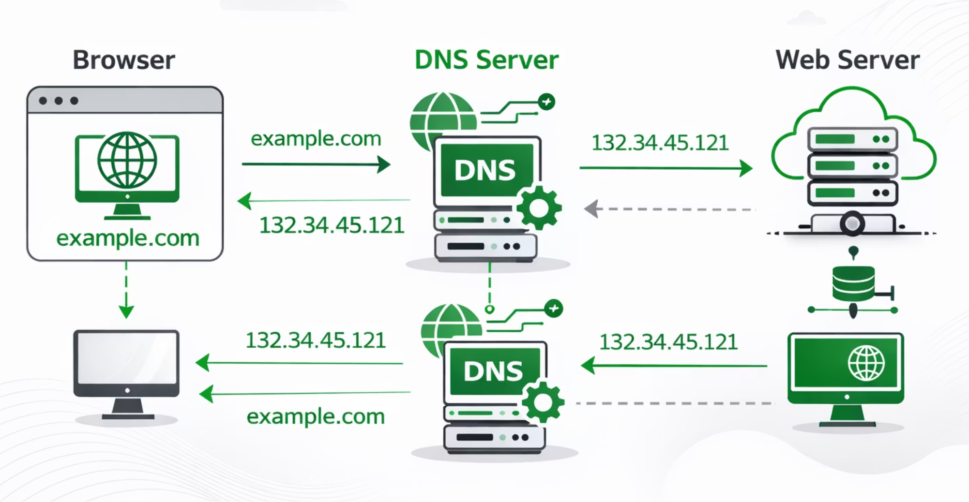
DNS Resolution Process
1
Type google.com
You enter the URL in your browser
2
Browser asks DNS
Request sent to DNS server
3
DNS returns IP
IP address is resolved
4
Browser connects
Connection made to that IP
8

Slide 9

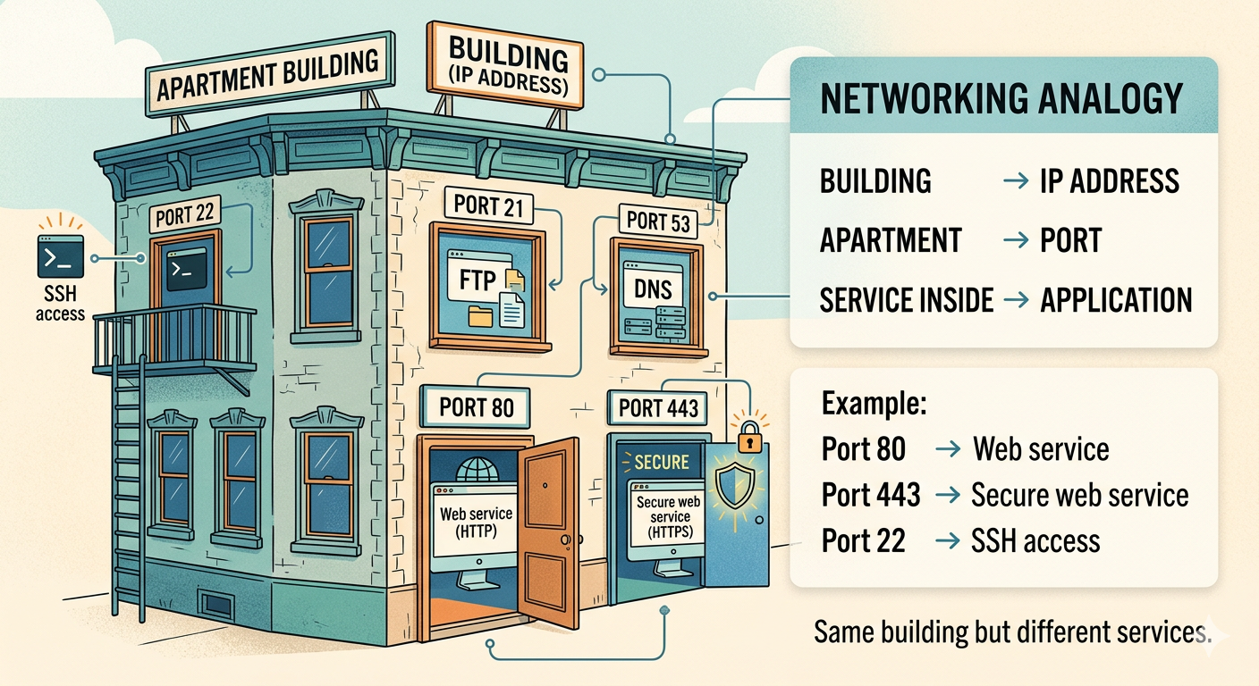
PORTS
What is a Port?
A port is a communication endpoint used to identify services on a server.
Think of it this way
Example:Apartment Building 🏢
IP Address = Building
Port = Apartment Number
Common Ports
Port
Protocol
Use
80
HTTP
Web (unsecured)
443
HTTPS
Web (secured)
22
SSH
Remote access
3306
MySQL
Database
9

Slide 10
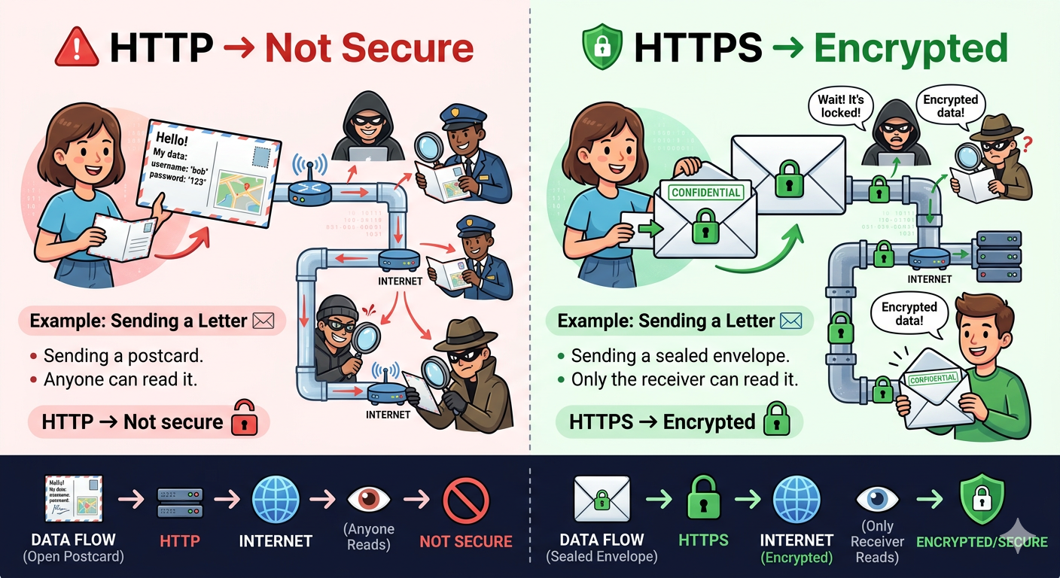
WHAT IS HTTPS?
HTTP vs HTTPS
Example: Sending a Letter ✉️
HTTP
Not secure
Data sent in plain text
Vulnerable to interception
HTTPS
Secure connection
Encrypted communication
S = Secure
10

Slide 11
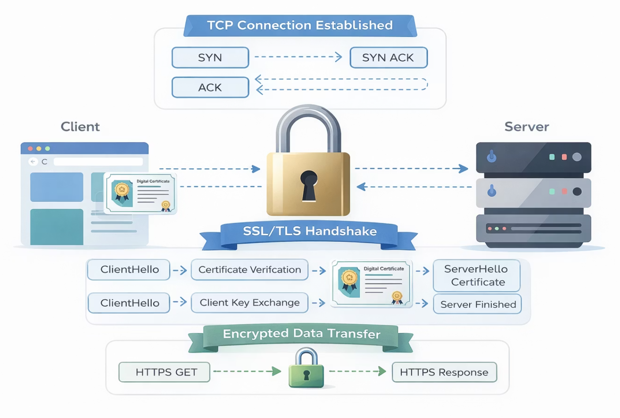
How HTTPS Works
HTTPS uses:
SSL/TLS Certificate
Verifies server identity
Encryption
Scrambles data in transit
Public & Private Keys
Asymmetric key exchange
The browser verifies the certificate before connecting.
11

Slide 12
Quiz Time
Q1. What do you think happens when you type a website name in the browser?
✅ Answer: The browser asks a DNS server for the IP address of that website.
Once it gets the IP address, the browser connects to the server and loads the webpage.
Q2. If a server has only one IP address, how can it run different services like websites and databases?
✅ Answer: Servers use ports to separate services. Each service runs on a different port number.
Example:
Web service → Port 80 or 443
SSH → Port 22
Q3. Why is HTTPS important when using websites like banking or shopping sites?
✅ Answer: HTTPS encrypts the data between the browser and the server, protecting passwords, payments, and personal information.
12

Slide 13





Why HTTPS is Important
Protects Passwords
Login credentials stay encrypted
Secures Payments
Banking and e-commerce rely on it
Prevents Data Theft
Stops eavesdropping on traffic
Builds Trust
Users trust the padlock icon
13

Slide 14
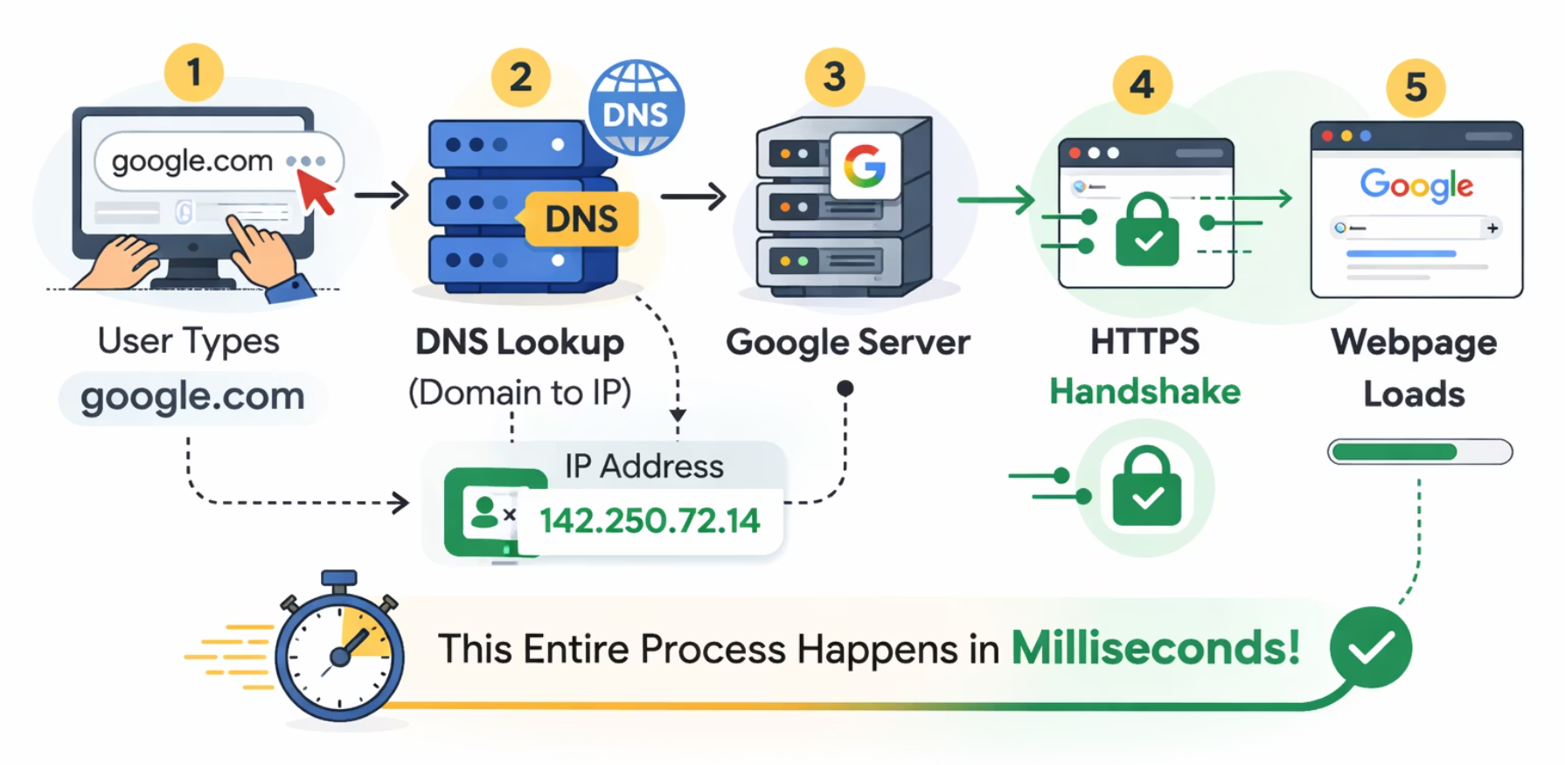
REAL-WORLD EXAMPLES
How Google Resolves a Domain Name
When you type google.com, this entire process happens in milliseconds:
1
2
3
4
5
DNS Lookup
IP Returned
Connect to Server
HTTPS Handshake
Webpage Loads
14

Slide 15
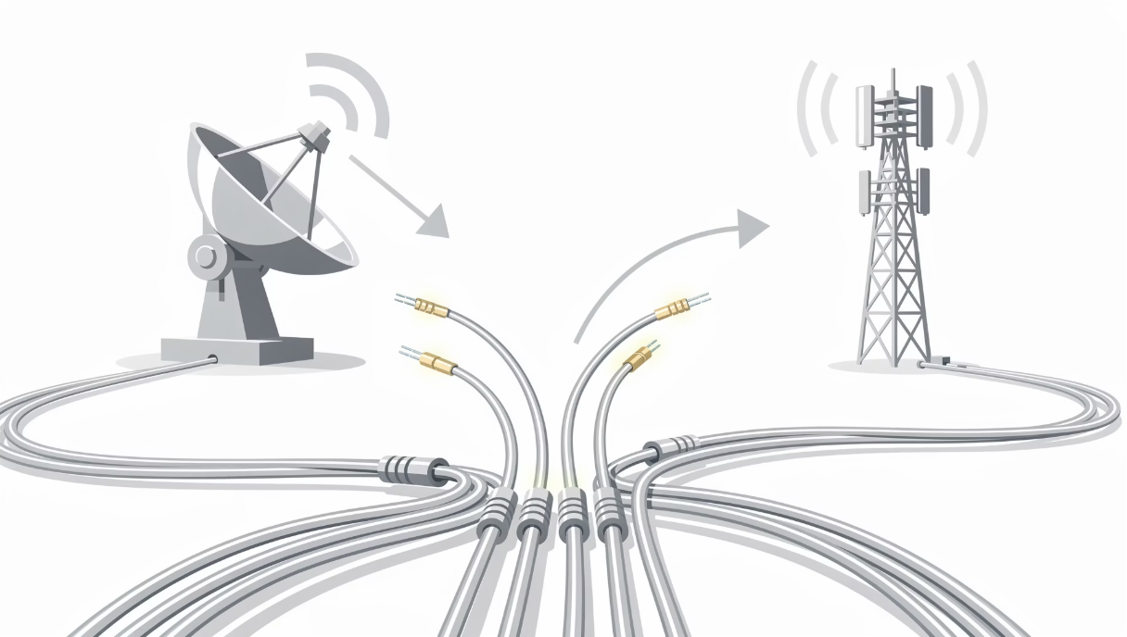



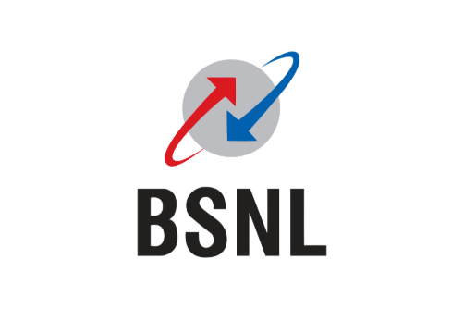
Role of the ISP
ISP = Internet Service Provider
Provides Connectivity
Assigns Public IP
Connects you to the internet
Your identity on the web
Routes Traffic
Directs data to its destination
Without an ISP → No Internet
Examples:
15

Slide 16
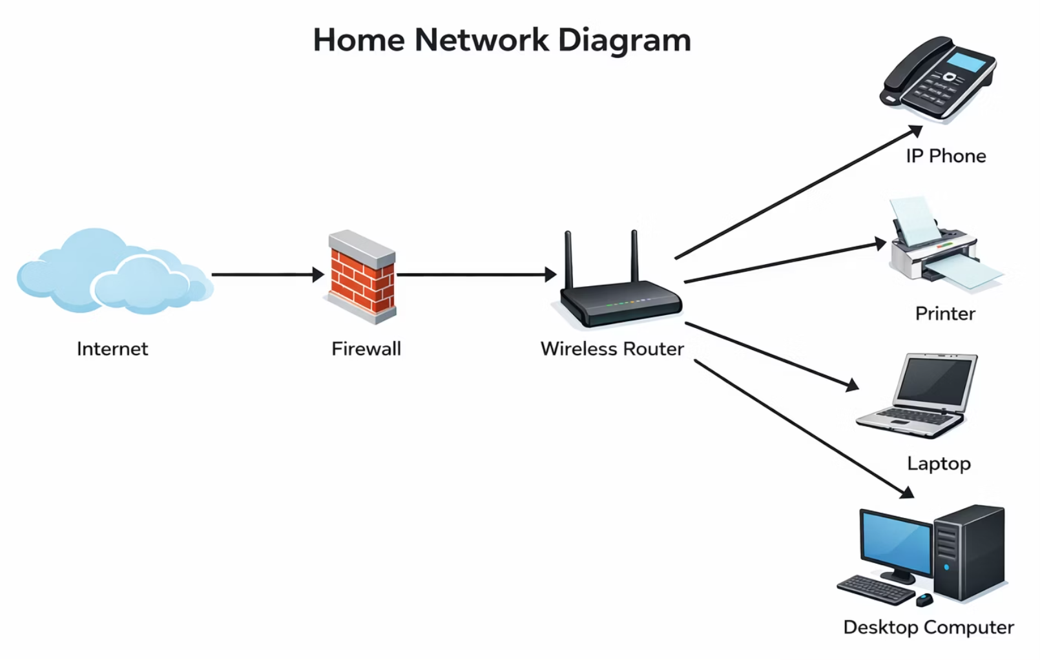
Home Router Explained
The router is the gateway between your devices and the internet.
Laptop → Router → ISP → Internet
Connects Devices
Assigns Private IPs
Performs NAT
Provides WiFi
Links all home devices
Via DHCP to each device
Translates private to public
Wireless connectivity
16

Slide 17
Quiz Time
Q1. What is the role of an ISP in providing internet access?
✅ Answer: An ISP (Internet Service Provider) provides the internet connection that allows devices to access websites and online services. Without an ISP, devices cannot connect to the internet.
Q2. Why do we need a router or WiFi at home?
✅ Answer: A router connects multiple devices in the home to the internet and allows them to share the same internet connection using WiFi.
Example:
Phone, laptop, and smart TV can all connect to the same WiFi network.
Q3. Why should a WiFi network always be protected with a password?
✅ Answer: To prevent unauthorized users from accessing the network and to protect personal data from hackers or misuse.
17

Slide 18




WIFI SECURITY BASICS
WiFi Security Types
Open WiFi
No password — Not secure
WEP
Old & insecure
WPA2
Secure — Recommended
WPA3
Most secure — Latest standard
Always use WPA2 or WPA3.
18

Slide 19

DEMO
Demo: ping command
ping checks connectivity to a server.
ping google.com
IP Address
Response Time
Packet Loss
Shows resolved IP
Latency in milliseconds
Connection reliability
Used to test: Is the server reachable?
19

Slide 20
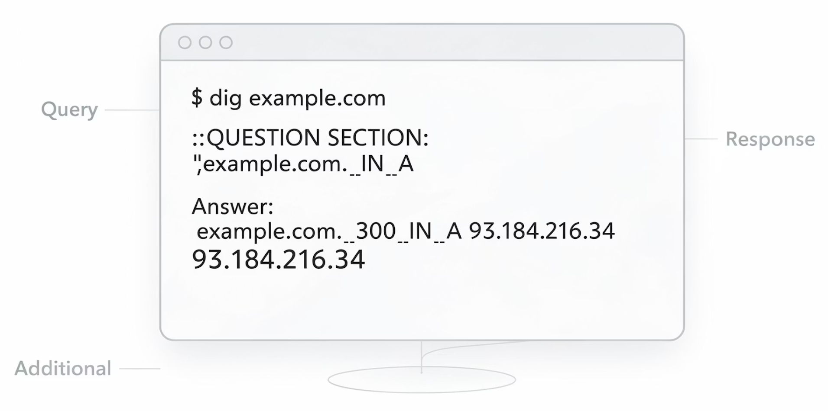
Demo: nslookup
nslookup google.com
It shows:
DNS server used for the query
IP address returned
Used to test DNS resolution — verify that domain names are translating to the correct IP addresses.
20

Slide 21
Show HTTPS Lock in Browser
1
Open any HTTPS website
2
Click the lock icon 🔒
3
View the certificate
Navigate to a secure site
Located in the address bar
See issuer & validity dates
A Certificate Authority verifies the website's identity so you can trust the connection.
21

Slide 22
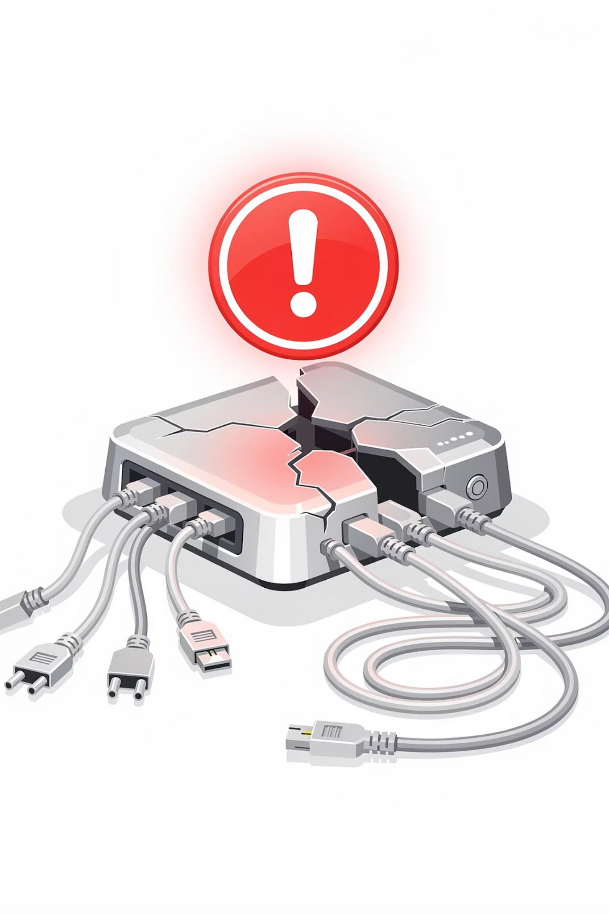
SCENARIO DISCUSSION
What Happens if the Router Fails?
⚠️ Impact
✅ Solutions
No internet access
Devices cannot reach ISP
DNS fails
Websites won't load
Restart the router
Replace the router
Contact your ISP
22

Slide 23

What If DNS Fails?
When DNS fails, your internet still works — but websites won't load by name.
IP addresses work manually, but domain names cannot be resolved.
Works ✅
Fails ❌
ping 8.8.8.8
google.com not loading
23

Slide 24


What If the ISP Fails?
When your ISP goes down, all external connectivity is lost.
No Public IP
No External Access
All Devices Offline
Cannot be identified online
Cannot reach any website
Only internal networks may work
24

Slide 25
DISCUSSION
Discussion Questions
1
Why do we need DNS?
2
Can two devices have the same IP?
3
Why is port 443 secure?
4
What happens during a man-in-the-middle attack?
5
Why should router firmware be updated?
25

Slide 26








SUMMARY
Key Takeaways
Internet
IP Addresses
DNS
Global network using IP & protocols
Public vs Private, NAT translation
Converts domains to IP addresses
Ports
HTTPS & Encryption
ISP, Router & WiFi
80 (HTTP), 443 (HTTPS)
SSL/TLS secures communication
Connectivity, NAT & WPA2/WPA3
Tools
ping, nslookup, Network tab
26

Slide 27

Thank You
27

